Slide 1
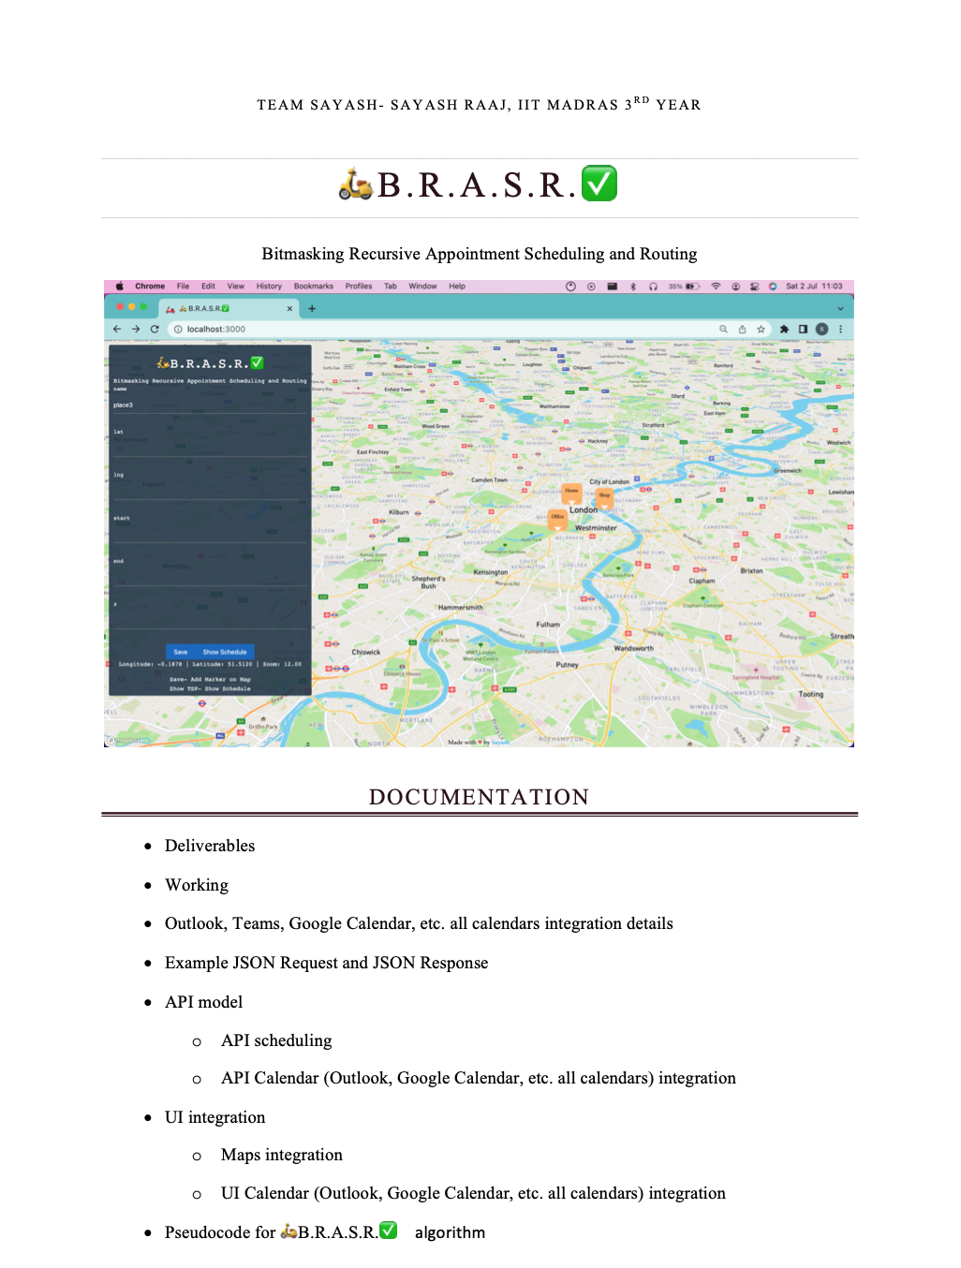
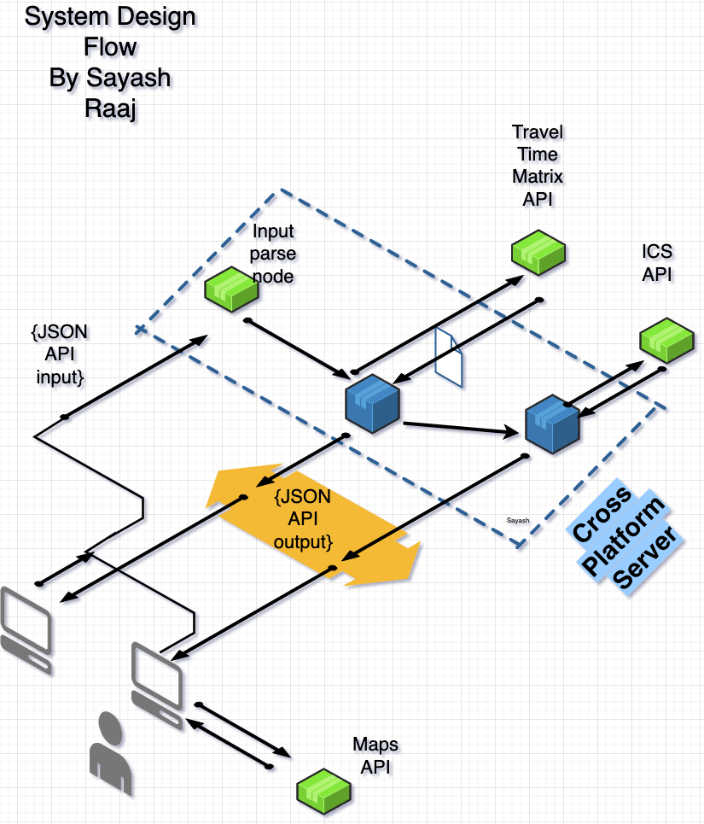


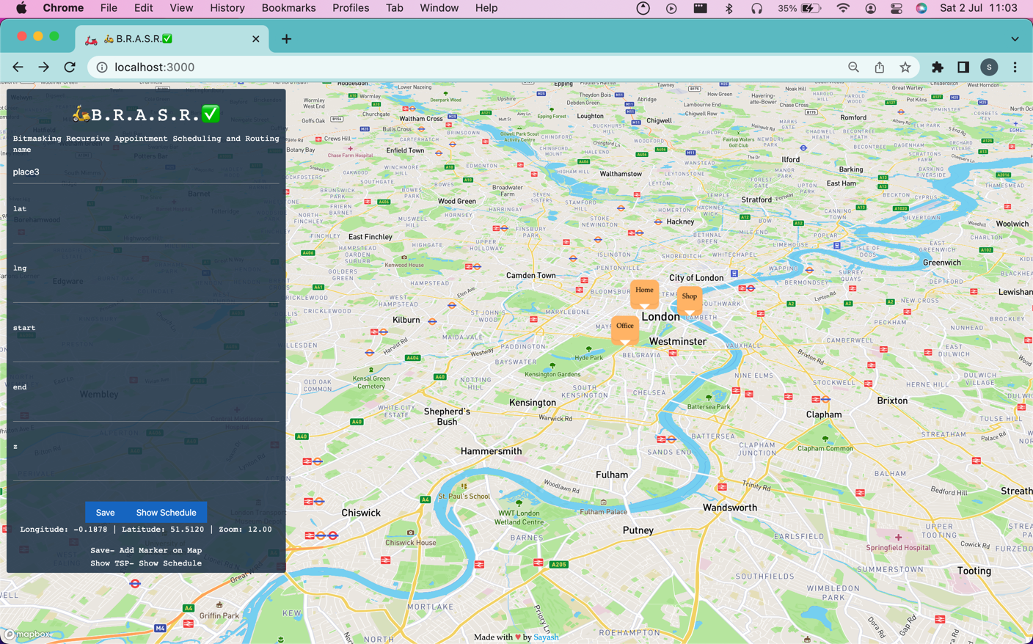
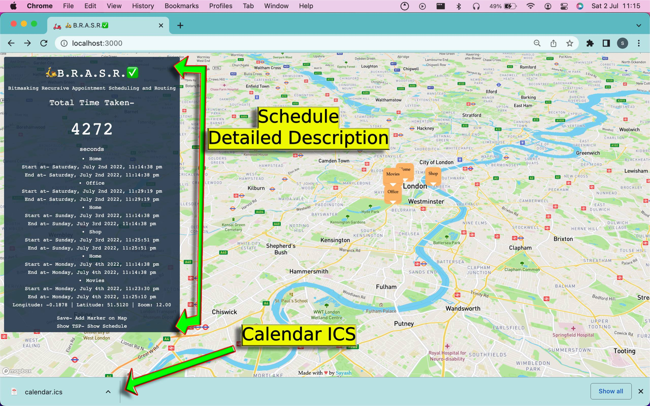
🛵B.R.A.S.R.✅
Bitmasking Recursive Appointment
Scheduling and Routing
Sayash Raaj,
IIT Madras
India
Solo Team
Credentials-
IIT Madras, 4th year student
Fidelity Investments USA, ex-intern
Harvard HPAIR Core Tech Associate
Amazon USA Intl’ App Contest Winner
SMEC Indo-Australian Scholarship’22
Kalidas Madhavpeddi IITM Scholarship’22

Slide 2

The issue
Commercial vehicular activities are the major contributors to the rising Carbon emissions out of all travel related activities (F Kamakate, L Schipper -Energy Policy, 2009 -Elsevier). Although commercial vehicular Carbon emissions cannot be nullified, they can be greatly reduced.
🛵B.R.A.S.R.✅- the solution is a customised 1960 Travelling Salesman Problem approach, outperforming industry algorithms

Slide 3
Deliverables
UI- Maps Integration
API- cross-platform server
🛵B.R.A.S.R.✅ custom algorithm
Universal Calendar Integration-Outlook,Teams,Google,Apple,Yahoo,etc.
Why 🛵B.R.A.S.R.✅ is the Winner
RESTful API- schedule, confirm appointments ✅
UI Maps interface- agenda, schedule visualised ✅
Universal calendar integration- Integrates with any calendar on Earth ✅
One-click solution- literally, fully automated ✅
Stateless deAuth approach for null security, privacy-first approach ✅
GDPR-compliance free, useful for international operations
User data, credentials never stored- completely secure

Slide 4

1. UI approach- maps
Demo video-
https://www.youtube.com/watch?v=Fy3PzsIi8Iw
Maps integration displays all locations input by user
Home node is genesis node, first location input by user
No limit on number of nodes or locations

Slide 5
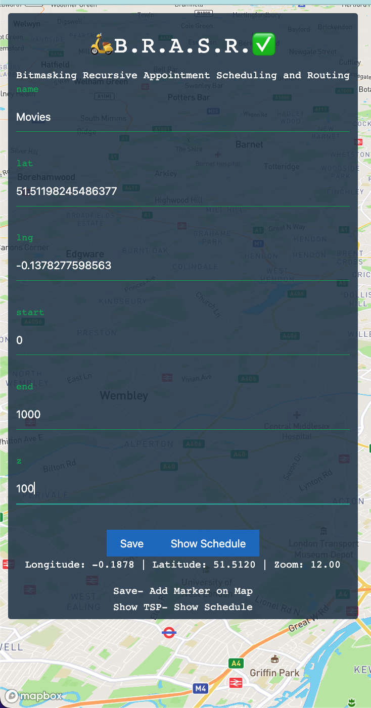
Input form- appending locations input by user- node creation at instant
New node created and displayed, dynamic real-time Maps integration

Slide 7
2. Api- 🛵B.R.A.S.R.✅ wins
Detailed documentation-
https://github.com/sayashraaj/Sayash-BRASR-IBM/blob/main/Combined%20Documentation-%20Read%20First-%20REST%20API%2C%20Outlook%2C%20Teams%2C%20Maps%20Integration.pdf

Slide 8
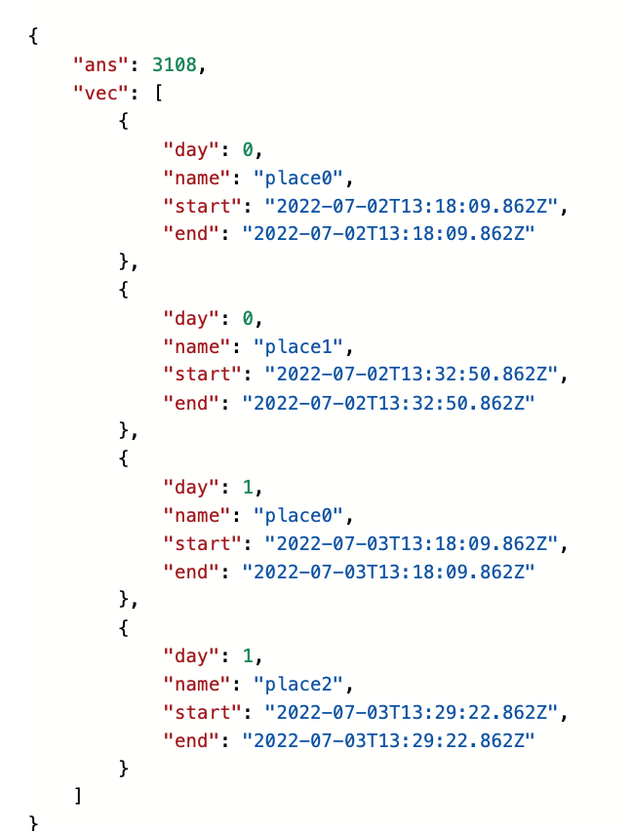
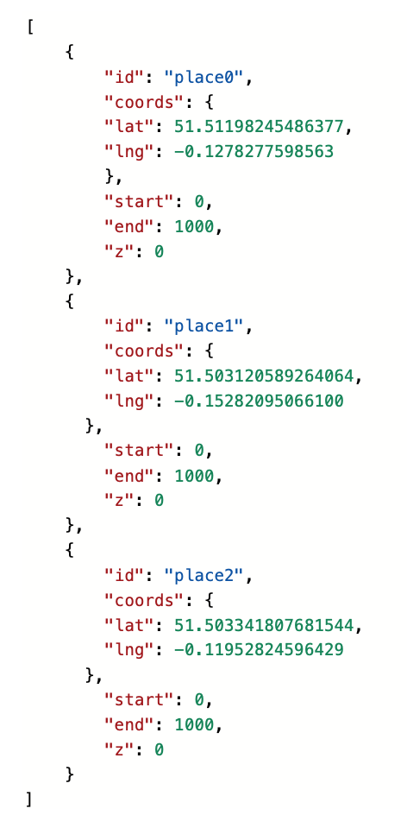
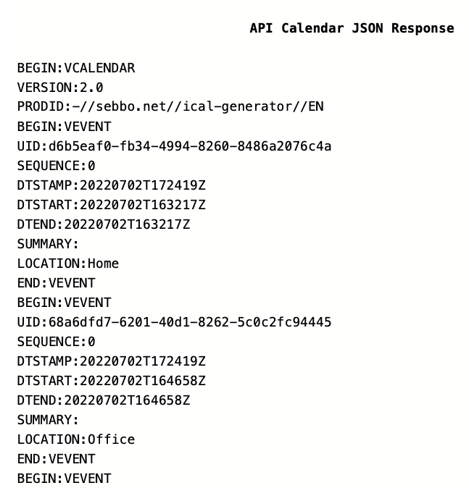
API simplified as easy as 1,2,3
API output
a) Scheduling and routing
Cross-platform server
API input
API output
b) User-customisable, shareable calendar integration file

Slide 9
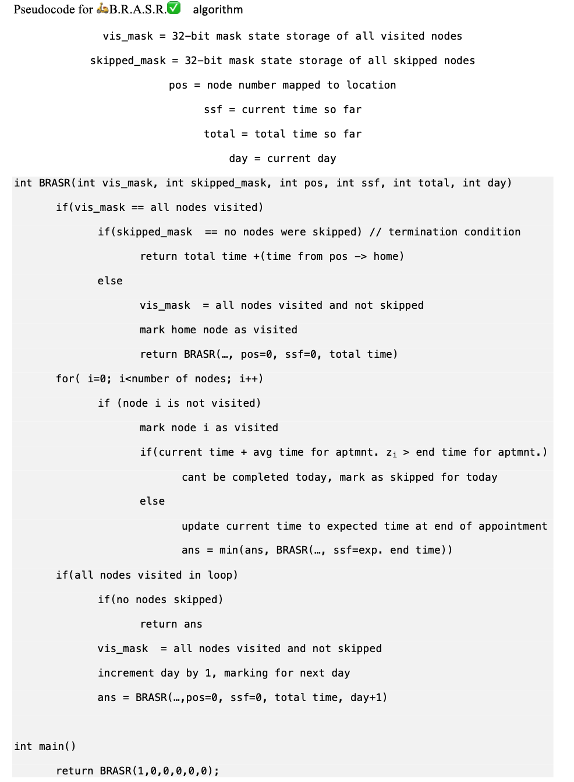
🛵B.R.A.S.R.✅ custom algorithm
Built upon the Travelling Salesman Problem- a 90-year old NP-hard problem
Uses Bitmasking- 3200% less memory usage than classical approach
Uses recursion- fully automated, one-click solution
Uses a 32-bit Bitmasking Recursive approach using an NP-hard solution framework
Recursively finds the shortest path w.r.t time with given constraints
Uses graph-algorithmic approach
Uses bitmasking to store mid-execution state of algorithm

Slide 10
Outlook, Teams, and all calendars integration
ICS-based approach- A Business-centric efficient approach
Stateless management of activities. Auth integration not required, anonymous user calendar generation
Secure with null privacy concerns as opposed to sharing auth details/token to integrate calendar
Shareable calendar, can be shared inside and outside office team, including vendors, friends, clients, potential clients, etc
Generated and downloaded automatically- one-click approach

Slide 11
Why 🛵B.R.A.S.R.✅ wins
🛵B.R.A.S.R.✅ goes beyond the hackathon project requirements
Can be integrated with ANY calendar on Earth (Outlook, Teams, Google, Yahoo, Apple, etc)
Average appointment time can be customised for ALL locations individually
Stateless deAuth approach for null security, privacy-first approach
These are a few business-centric advantages where 🛵B.R.A.S.R.✅ is years ahead of its time
To infinity and beyond- there exists no upper bound on the number of locations, the algorithm has no limit
Complies with ALL data protection compliance procedures, including EU GDPR compliance
EXL, an international organisation, will benefit with the stateless deAuth approach of this project, with no roadblocks when operating across borders

Slide 12
🛵B.R.A.S.R.✅
Thank you
Bitmasking Recursive Appointment
Scheduling and Routing
Sayash Raaj,
IIT Madras,
India
Special Thanks to the IBM Team for conducting this hackathon
The hard work during late nights while balancing academics at IIT Madras has been fueled by motivation adequately provided by IBM
Thank you for the opportunity to present a solution for a real-world business case
I hope to work with IBM as an FTE in the future, where we change how the world works, making sense of data and driving business forward
https://www.linkedin.com/in/sayashraaj/

